Slide 1

GLOBAL TERRORISM Github link : https://github.com/Sreenath107 Project Submitted By : SREENATH K Submitted on : 04-08-2021

Slide 2
Context
Information on more than 180,000 Terrorist Attacks The Global Terrorism Database (GTD) is an open-source database including information on terrorist attacks around the world from 1970 through 2017. The GTD includes systematic data on domestic as well as international terrorist incidents that have occurred during this time period and now includes more than 180,000 attacks. The database is maintained by researchers at the National Consortium for the Study of Terrorism and Responses to Terrorism (START), headquartered at the University of Maryland.

Slide 3
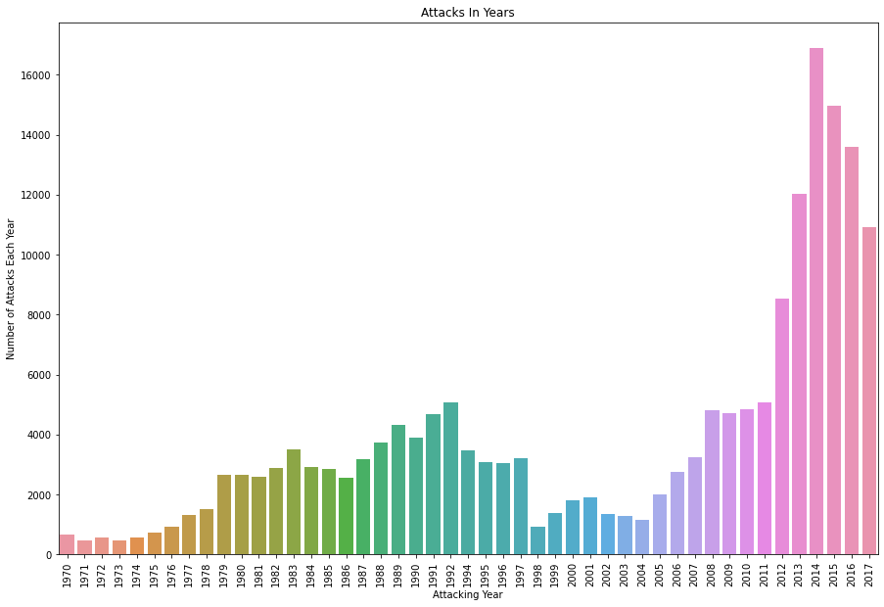
1. Year Vs Attacks As per this analysis, 2014 is the year most of the attacks were held. Since then, 2015 and 2016. In 2017 it is decreased than in 2013. After 2000, the Terrorism in the world is increased. In the 1970's the number of attacks is below 1000. In 2014, 16000+ attacks were held in the world. But in 2017, it decreased to 11000. So, the country's made more security measures than in 2014.

Slide 4
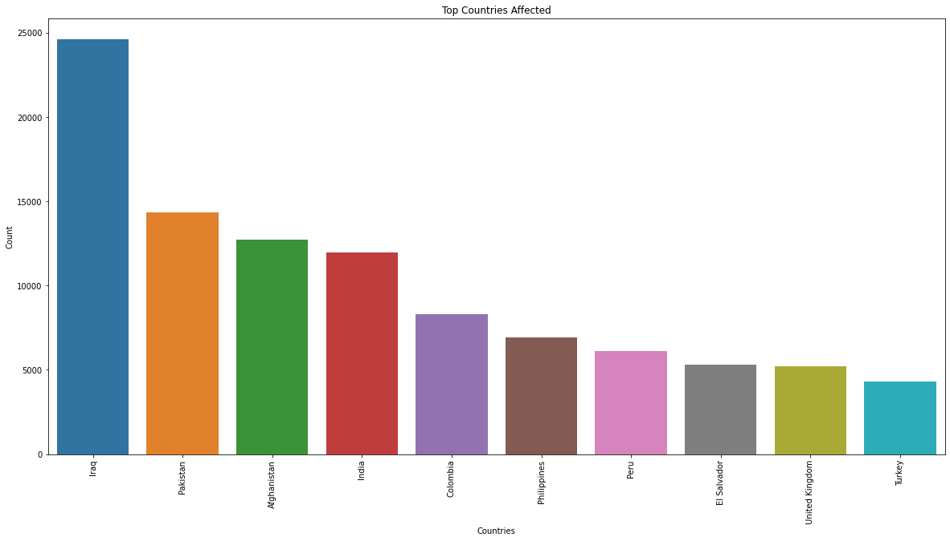
2. Top Affected Countries As per this result, most of the attacks are carried out in Iraq, Pakistan, Afghanistan and India. The major terrorist groups are located in the first three countries. In India there are 12,000+ attacks held. In India we do not promote terrorism. So the terrorist groups are aiming at India. Depending on this result, India wants to take more security measures to restrict the attacks.

Slide 5
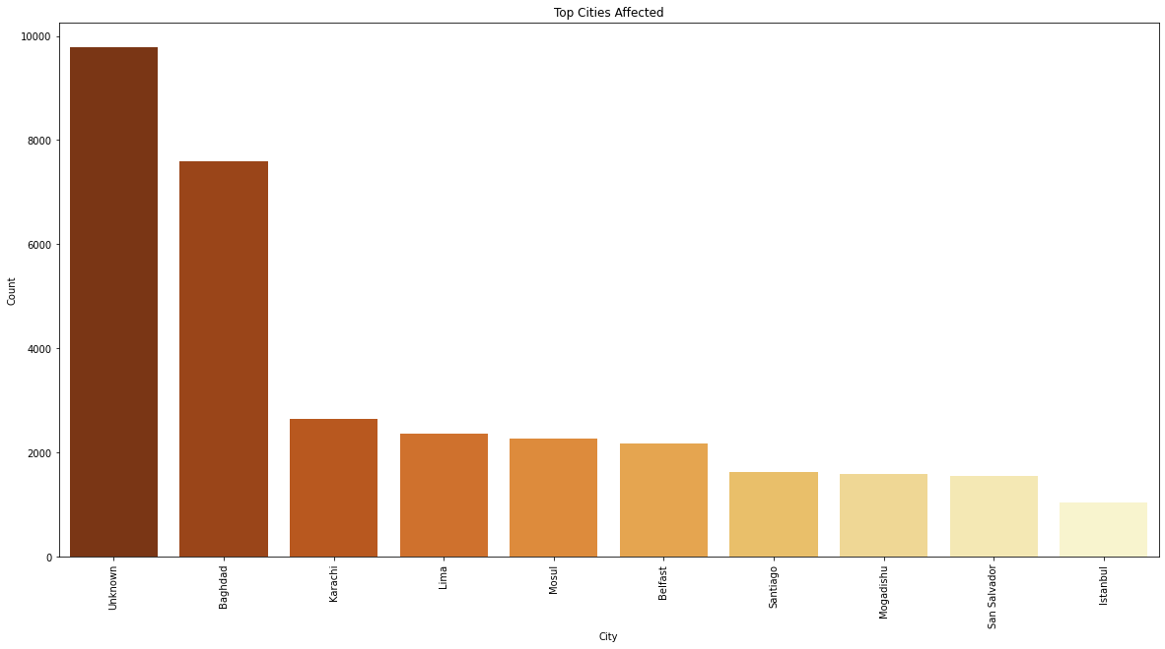
3.Top affected Cities In this analysis, most of the attacks were held in unknown cities. The small cities are affected by most of the attacks. As per the analysis based on the capital cities, Baghdad is the capital city that has effected most of the attacks. Karachi in Pakistan is the second effected city. Then followed by Lima, Mosul, Belfast and so on.

Slide 6
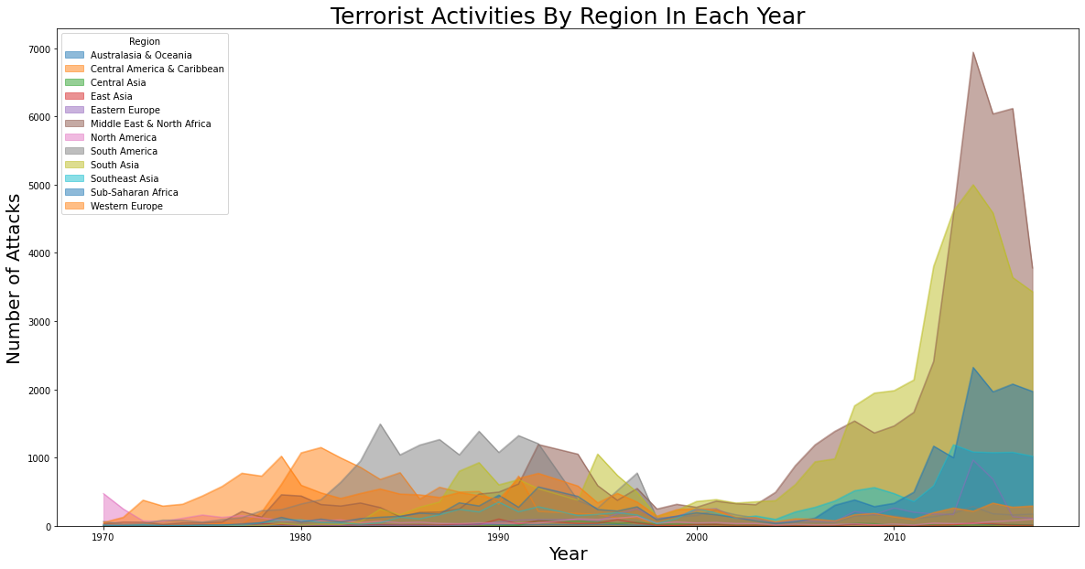
4. Activity each year As for this result, at the beginning of the 1970's western Europe was the most effected region in the world. But after 2010, most of the attacks were taken in the Middle East & North Africa. In this analysis, we can easily find that the terrorism is spread to the Middle East of the world. The attacks points to the presence of the terrorist groups.

Slide 7
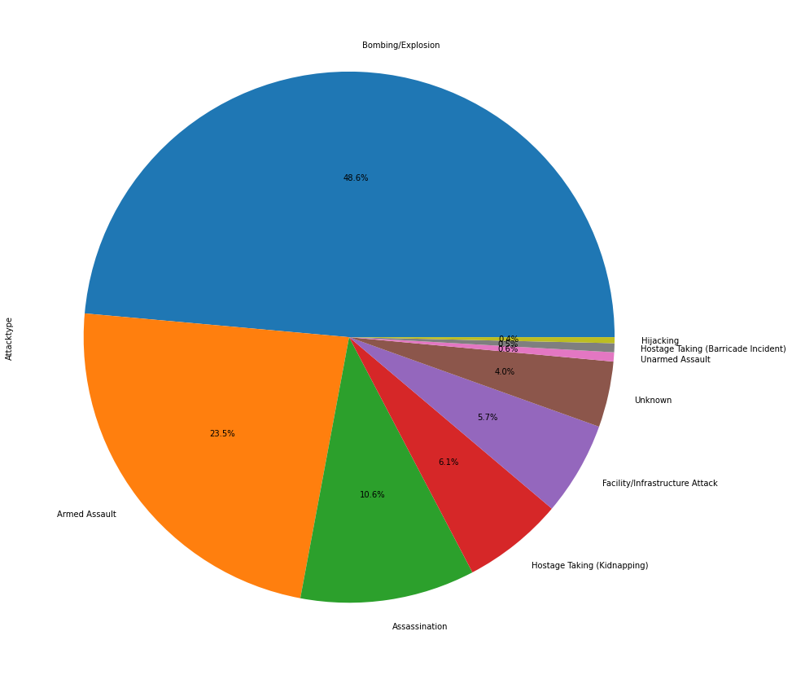
5. Attack Types In this analysis we have seen that their attack type. The most of the attacks were done by the Bombing/Explotion. Around 50% of the attacks are by the explotion. The armed assault is the second way of their attack. So that if the country's make tight security to important cities or places, it will reduce the attacks of the terrorist groups by the bombing attack.

Slide 8
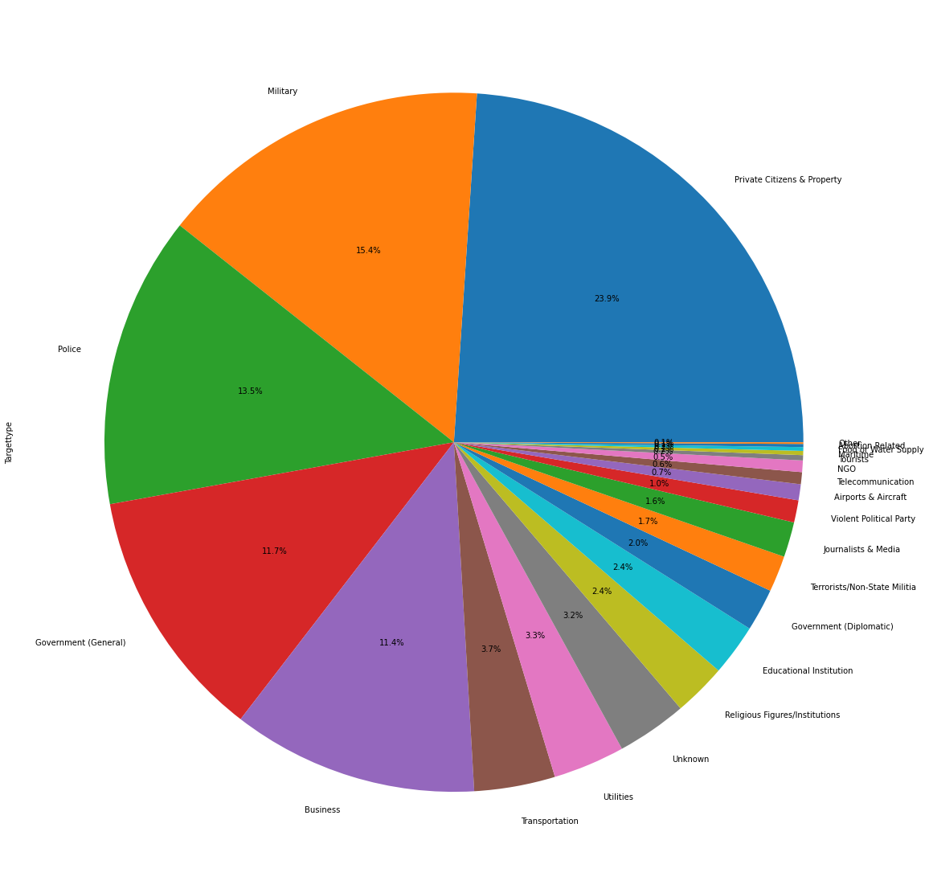
6. Target Types In this analysis, private citizens and properties are affected most. Then they were attacked to the military and Police.

Slide 9
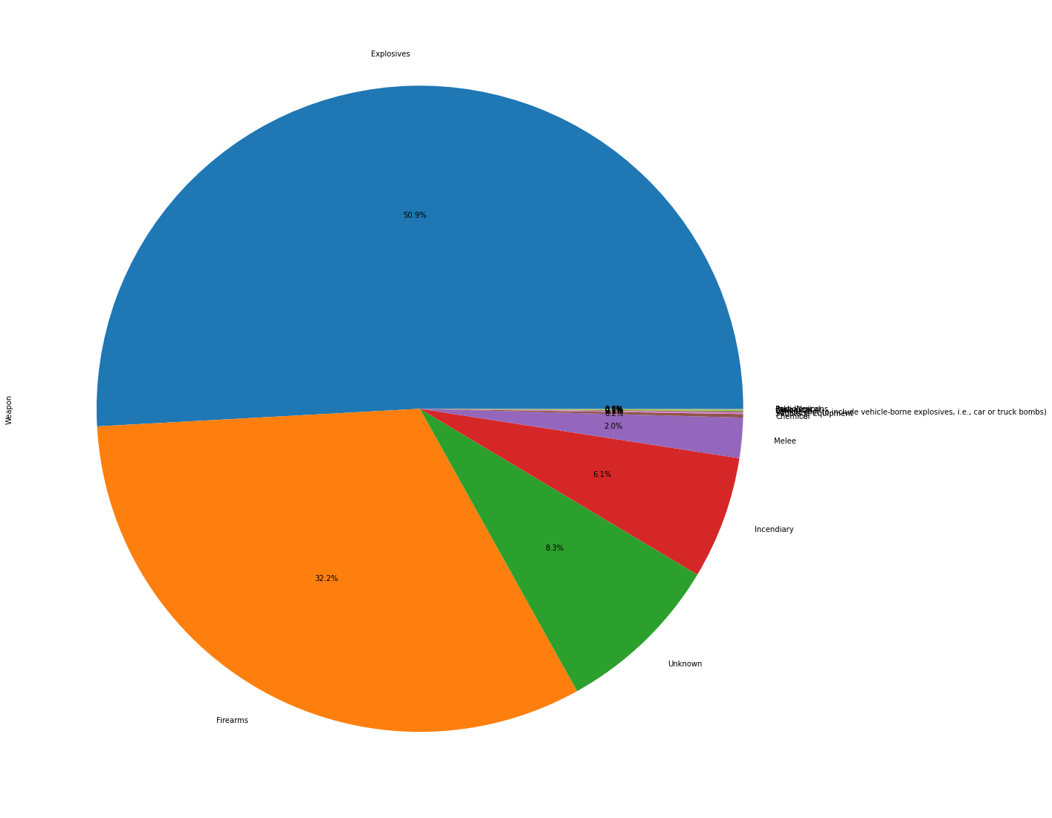
7. Weapon Types As per the above analysis, bombing is the way the terrorist attacks most. So we can control the attacks if we control the trade of explosives.

Slide 10
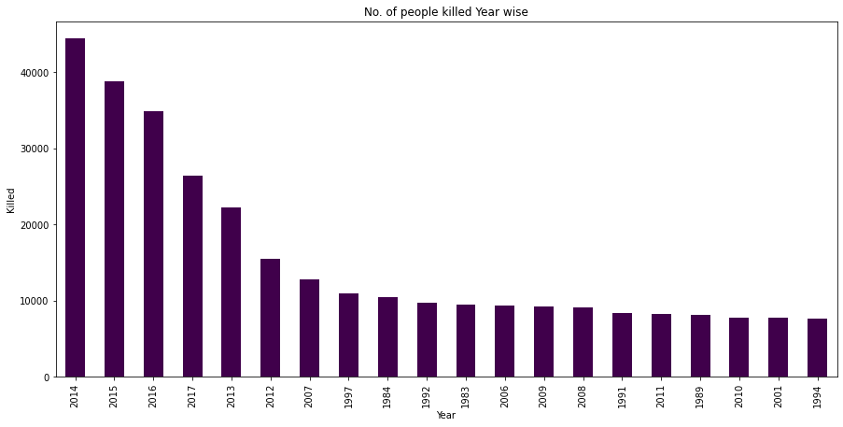
8. Deaths in Years As per this analysis, we can see that the number of kills increases by year by year. So we can conclude that year-wise terrorism increases in the world.

Slide 11
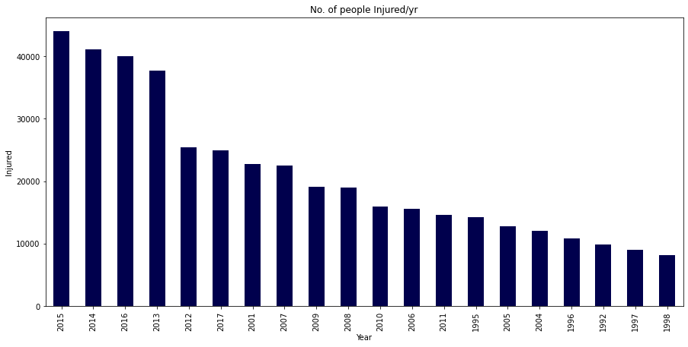
9. Injured vs Year As for this analysis, I analyze the year-wise injured people ratio. In the previous analysis, 2014 is the year most of the attacks were held in the world. But most of the injured people in the year 2015.

Slide 12
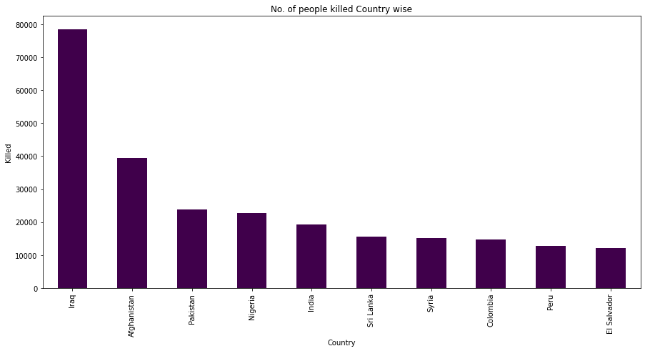
10. Killed vs Country As per previous analysis, India is the 4th country that most of the attacks have done. We here analyze the number of the people killed country-wise. In this analysis, we have found that most of the people are killed from Iraq, and it is in the 1st place, then Afghanistan and Pakistan are the 2nd and 3rd place. Nigeria is the 4th country in which most of the people died due to a terrorist attack. So that we can conclude that attack per murder has been controlled in India.

Slide 13
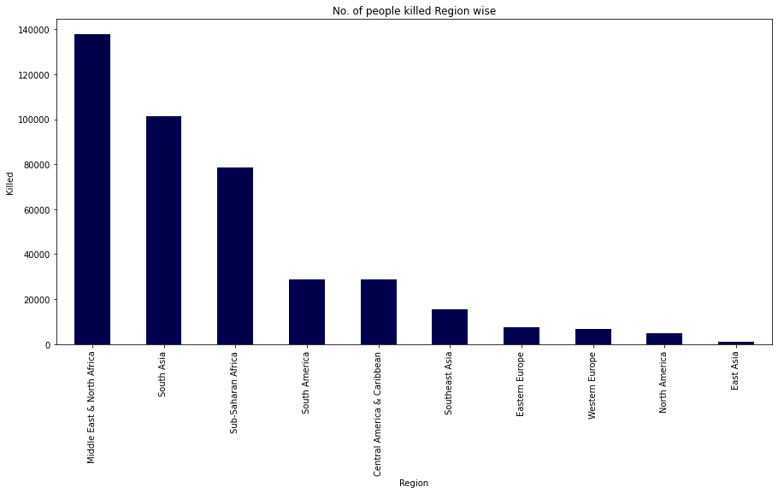
11. Killed vs Region As per this graph, we can see that most of the people killed in the Middle East& North Africa.

Slide 14
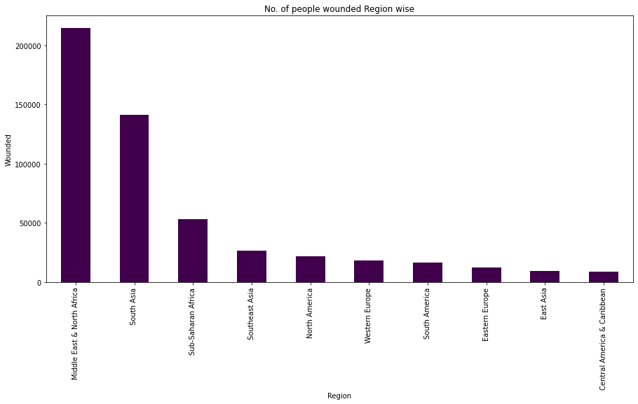
12. Wounded vs Region In this analysis we can see that wounded person ratio. In the previous analysis, most of the people killed in the Middle East and North Africa. In connection with the previous analysis, we can see most of the wounded person located in the same region.

Slide 15
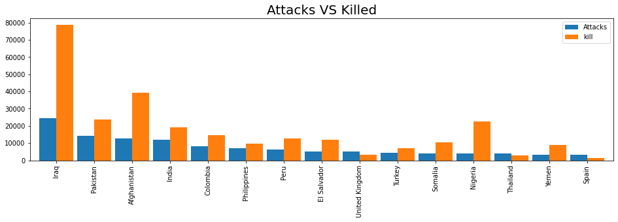
13. Attacks VS Killed As per this analysis, we can see the attack vs death ratio. Most of the attacks are held in Iraq as well as death.

Slide 16
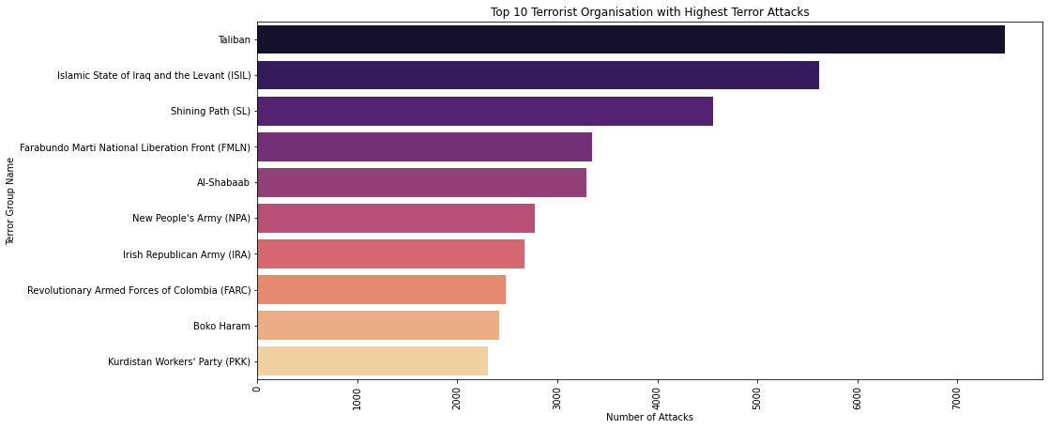
14. Terror Groups This analysis is used to find the most dangerous terrorist group. As per this graph, we can see that the Taliban is the most dangerous group. Most of the attacks have been done by the group Taliban.

Slide 17
Conclusion and Results :
Country with the most attacks: Iraq
City with the most attacks: Baghdad
Region with the most attacks: Middle East & North Africa
Year with the most attacks: 2014
Most Injury caused Year: 2015
Most Attack Types: Bombing/Explosion
Most Targeted: Private Sector
Most Weapon used: Explosives
Group with the most attacks: Taliban
Sincere thanks to the site Kaggle as well as Google, Mr. Manvendra and University of Maryland.

